Slide 1




HOUSING: PRICE PREDICTION
Houses are one of the necessary need of each and every person around the globe and therefore housing and real estate market is one of the markets which is one of the major contributors in the world’s economy. It is a very large market and there are various companies working in the domain. Data science comes as a very important tool to solve problems in the domain to help the companies increase their overall revenue, profits, improving their marketing strategies and focusing on changing trends in house sales and purchases. Predictive modelling, Market mix modelling, recommendation systems are some of the machine learning techniques used for achieving the business goals for housing companies. Our problem is related to one such housing company.
A US-based housing company named Surprise Housing has decided to enter the Australian market. The company uses data analytics to purchase houses at a price below their actual values and flip them at a higher price. For the same purpose, the company has collected a data set from the sale of houses in Australia. The data is provided in the CSV file below.

Slide 2
Technical Requirements:
Data contains 1460 entries each having 81 variables.
Data contains Null values. You need to treat them using the domain knowledge and your own understanding.
Extensive EDA has to be performed to gain relationships of important variable and price.
Data contains numerical as well as categorical variable. You need to handle them accordingly.
You have to build Machine Learning models, apply regularization and determine the optimal values of Hyper
Parameters.
You need to find important features which affect the price positively or negatively. Two datasets are being provided to you (test.csv, train.csv). You will train on train.csv dataset and predict on test.csv file.

Slide 3

Problem Statement:
The company is looking at prospective properties to buy houses to enter the market. You are required to build a model using Machine Learning in order to predict the actual value of the prospective properties and decide whether to invest in them or not. For this company wants to know:
Which variables are important to predict the price of variable?
How do these variables describe the price of the house?

Slide 4
Understanding:
There are 2 csv file in the dataset that has been shared.
First, csv file is the train.csv where data are for the training. Second, csv file is test.csv where data are for testing.
There are information of Houses in Australia.
The information can be good as well as bad feedbacks.
The dataset is about the house:
Year built
Condition
Area
Style
Garage and all other stuffs.

Slide 5

EDA:
Shape of first dataset is 1168, 81.
Information of dataset:
RangeIndex: 0 to 1167.
Data columns: 81.
dtypes: float64(3), int64(35), object(43).

Slide 6
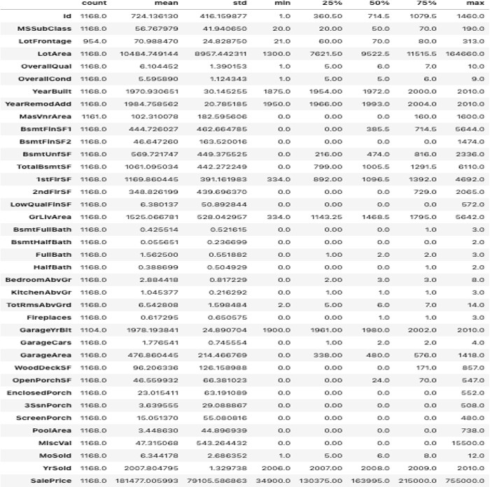
Descriptive Statistic:

Slide 7
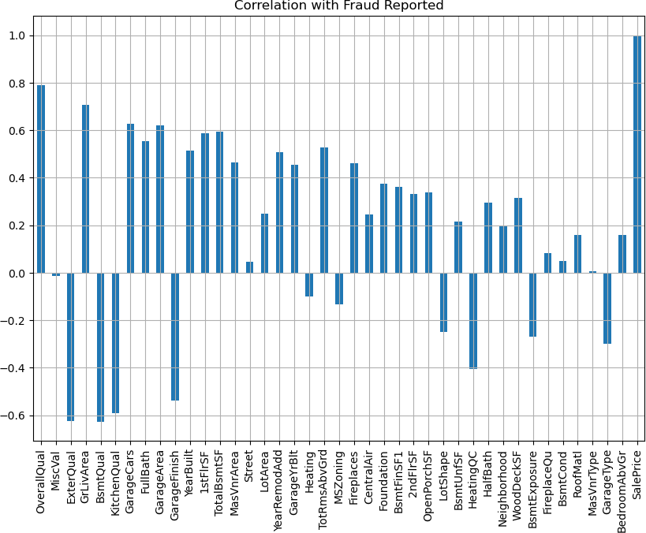
TOP 40 FEATURES:

Slide 8
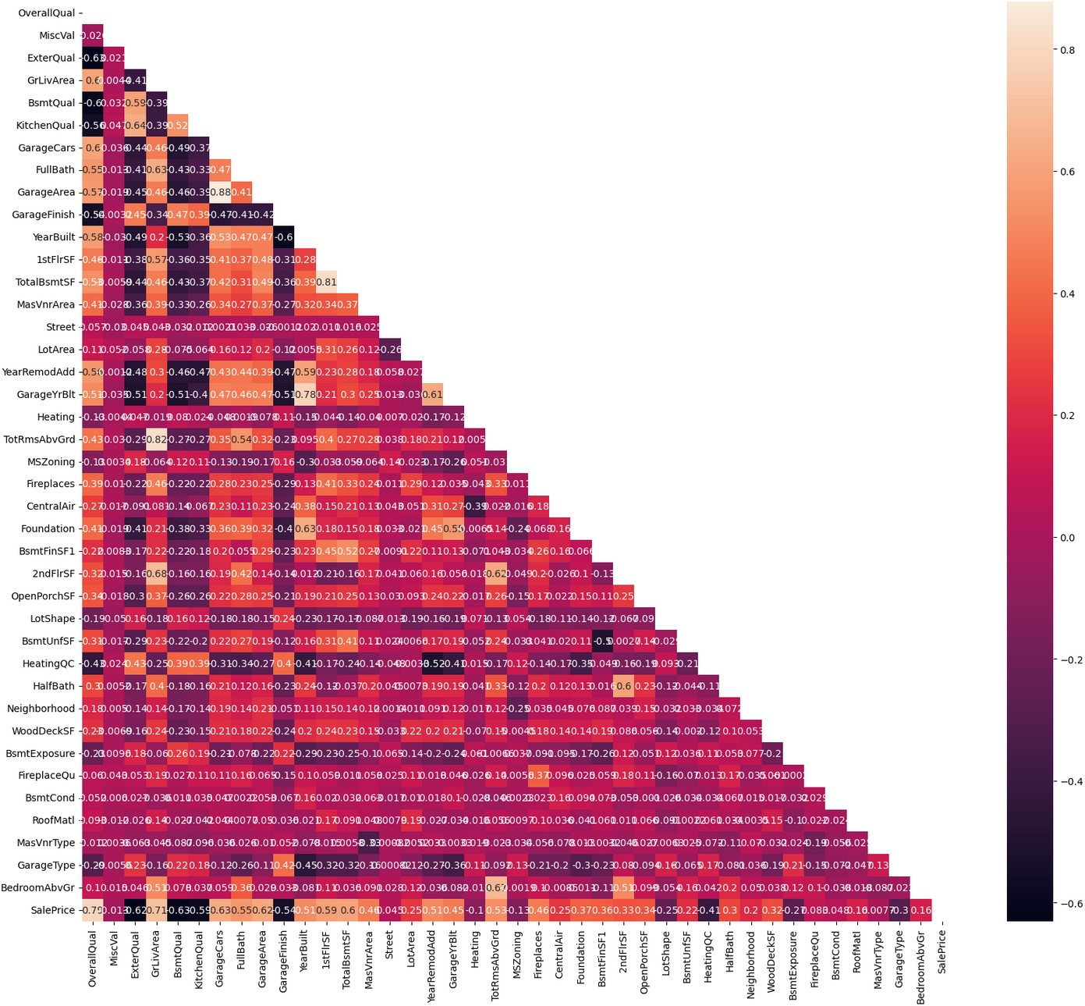
There are multicollinearity problem present in our dataset.
TotRmsAbvGrd & GrLivArea, has the correlation of 82%.
GarageArea & GarageCars, has the correlation of 88%. TotalBsmtSF & 1stFlrSF, has the correlation of 81%.

Slide 9
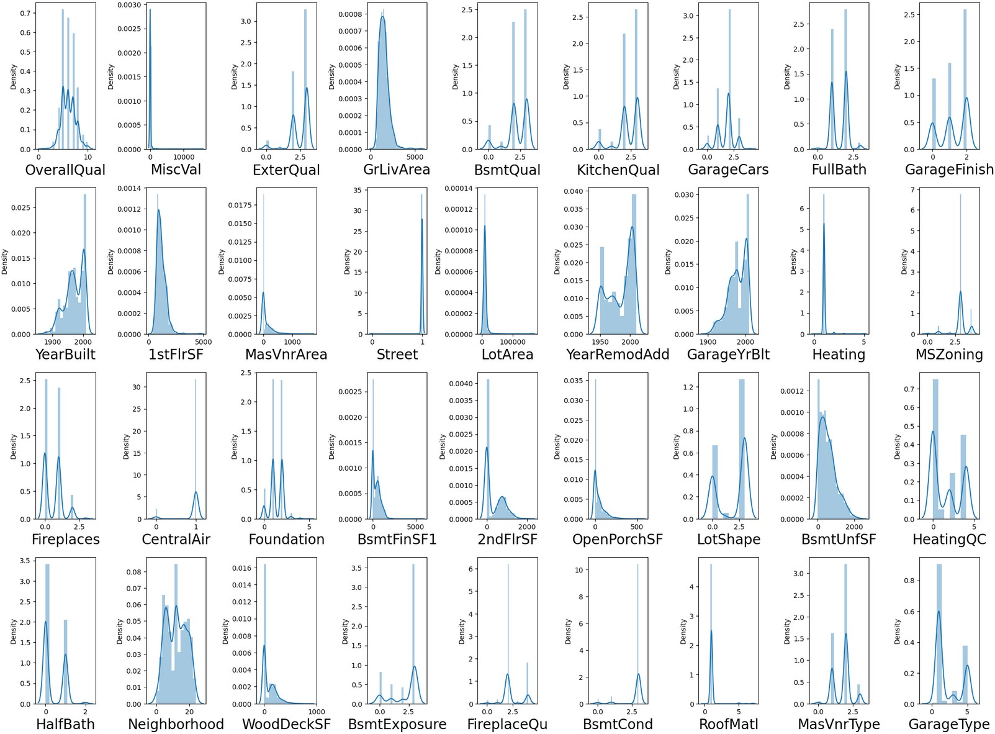
Normal Distribution:

Slide 10
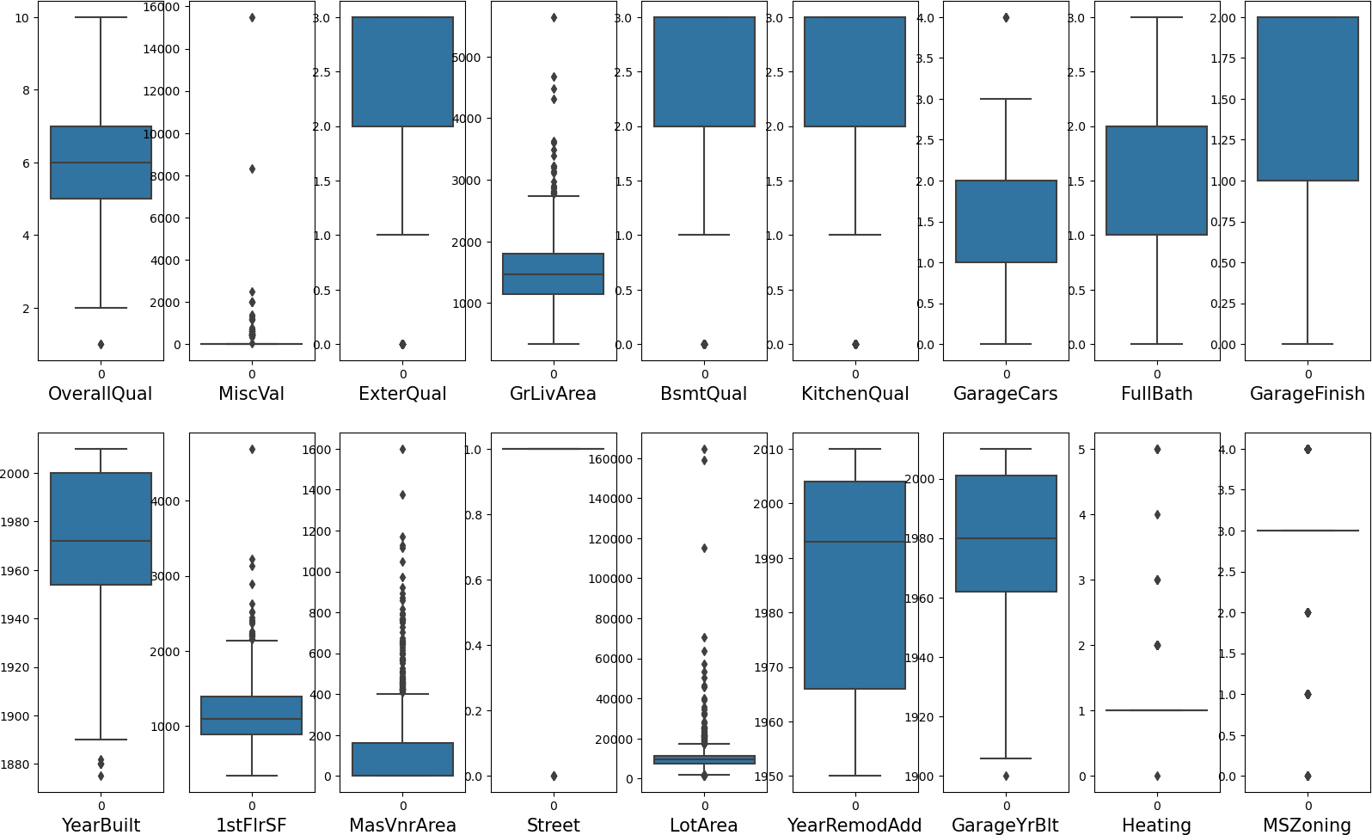
Outliers:

Slide 11
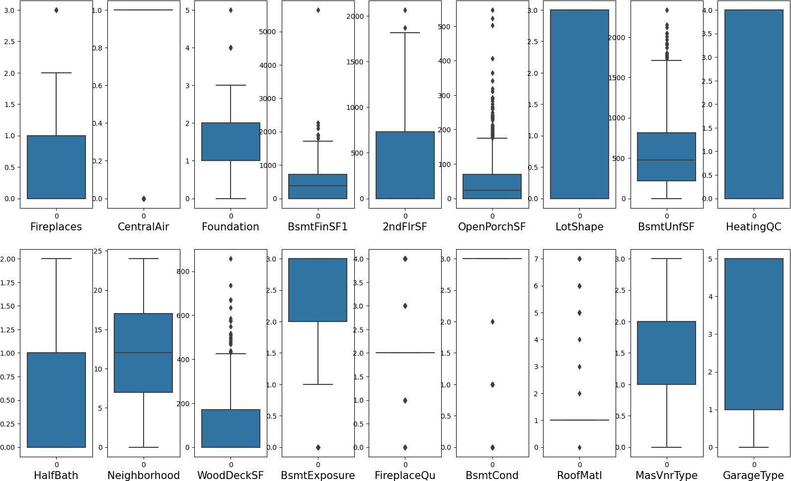

Slide 12
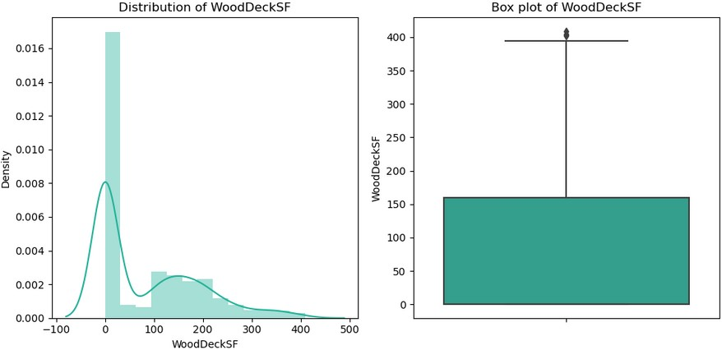
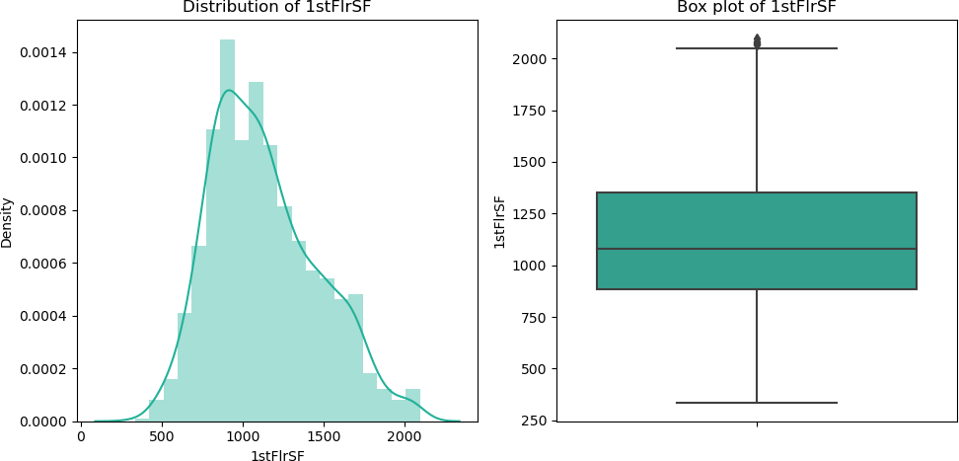
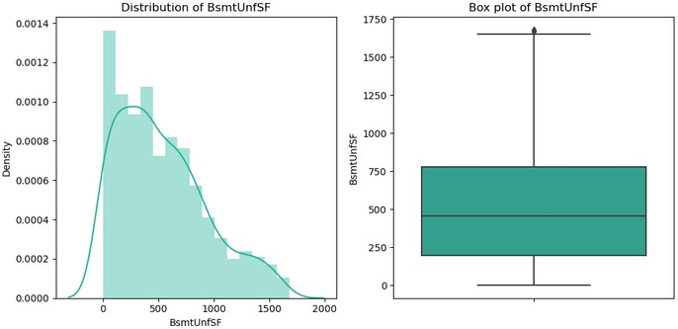
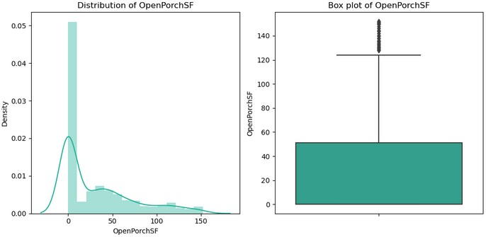
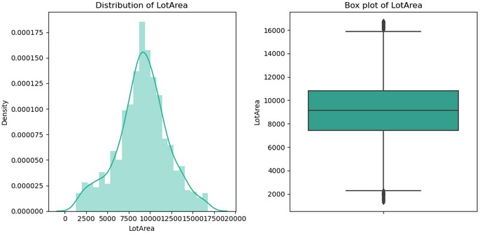
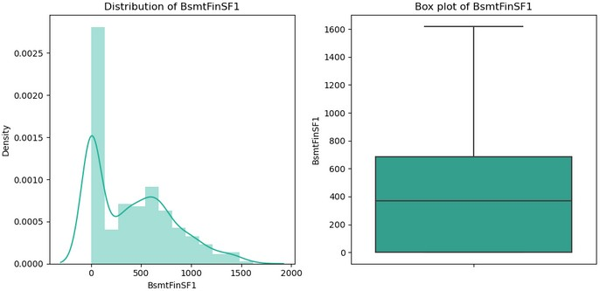
Removal of oultiers:

Slide 13
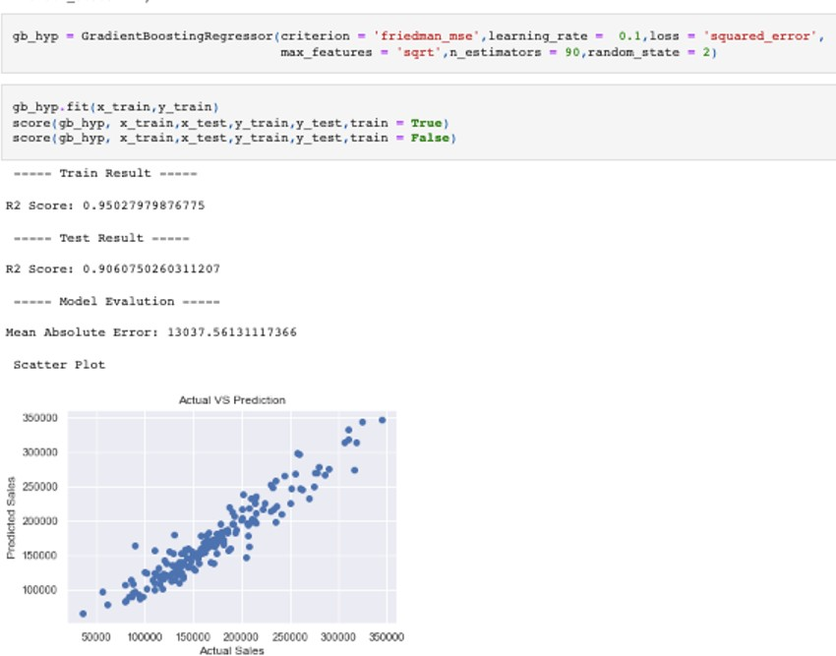
Best Model, Parameters & Score:
GradientBoosting Regressor

Slide 14


